Slide 1
RAID Redundant Array of Independent Disks
Disks are improving, but not as fast as CPUs
  1970s seek time: 50-100 ms.
  2000s seek time: <5 ms.
  Factor of 20 improvement in 3 decades
We can use multiple disks for improving performance
  By Striping files across multiple disks (placing parts of each file on a different disk), parallel I/O can improve access time
Striping reduces reliability
  100 disks have 1/100th mean time between failures of one disk
So, we need Striping for performance, but we need something to help with reliability / availability
To improve reliability, we can add redundant data to the disks, in addition to Striping

Slide 2
RAID
A RAID is a Redundant Array of Independent Disks
  In industry, “I” is for “Independent”
  The alternative is SLED, single large expensive disk
Disks are small and cheap, so it’s easy to put lots of disks (10s to 100s) in one box for increased storage, performance, and availability
The RAID box with a RAID controller looks just like a SLED to the computer
Data plus some redundant information is Striped across the disks in some way
How that Striping is done is key to performance and reliability.

Slide 3
Some Raid Issues
Granularity
  fine-grained: Stripe each file over all disks. This gives high throughput for the file, but limits to transfer of 1 file at a time
  coarse-grained: Stripe each file over only a few disks. This limits throughput for 1 file but allows more parallel file access
Redundancy
  uniformly distribute redundancy info on disks: avoids load-balancing problems
  concentrate redundancy info on a small number of disks: partition the set into data disks and redundant disks

Slide 4
Raid Level 0
Level 0 is nonredundant disk array
Files are Striped across disks, no redundant info
High read throughput
Best write throughput (no redundant info to write)
Any disk failure results in data loss
  Reliability worse than SLED
Stripe 0
Stripe 1
Stripe 2
Stripe 3
Stripe 4
Stripe 5
Stripe 6
Stripe 7
Stripe 8
Stripe 9
Stripe 10
Stripe 11
data disks

Slide 5
Raid Level 1
Mirrored Disks
Data is written to two places
  On failure, just use surviving disk
On read, choose fastest to read
  Write performance is same as single drive, read performance is 2x better
Expensive
Stripe 0
Stripe 1
Stripe 2
Stripe 3
Stripe 0
Stripe 1
Stripe 2
Stripe 3
Stripe 4
Stripe 5
Stripe 6
Stripe 7
Stripe 4
Stripe 5
Stripe 6
Stripe 7
Stripe 8
Stripe 9
Stripe 10
Stripe 11
Stripe 8
Stripe 9
Stripe 10
Stripe 11
data disks
mirror copies

Slide 6
Parity and Hamming Codes
What do you need to do in order to detect and correct a one-bit error ?
  Suppose you have a binary number, represented as a collection of bits: <b3, b2, b1, b0>, e.g. 0110
Detection is easy
Parity:
  Count the number of bits that are on, see if it’s odd or even
    EVEN parity is 0 if the number of 1 bits is even
  Parity(<b3, b2, b1, b0 >) = P0 = b0 ⊗ b1 ⊗ b2 ⊗ b3
  Parity(<b3, b2, b1, b0, p0>) = 0 if all bits are intact
  Parity(0110) = 0, Parity(01100) = 0
  Parity(11100) = 1 => ERROR!
  Parity can detect a single error, but can’t tell you which of the bits got flipped

Slide 7
Parity and Hamming Code
Detection and correction require more work
Hamming codes can detect double bit errors and detect & correct single bit errors
7/4 Hamming Code
  h0 = b0 ⊗ b1 ⊗ b3
  h1 = b0 ⊗ b2 ⊗ b3
  h2 = b1 ⊗ b2 ⊗ b3
  H0(<1101>) = 0
  H1(<1101>) = 1
  H2(<1101>) = 0
  Hamming(<1101>) = <b3, b2, b1, h2, b0, h1, h0> = <1100110>
  If a bit is flipped, e.g. <1110110>
  Hamming(<1111>) = <h2, h1, h0> = <111> compared to <010>, <101> are in error. Error occurred in bit 5.

Slide 8
Raid Level 2
Bit-level Striping with Hamming (ECC) codes for error correction
All 7 disk arms are synchronized and move in unison
Complicated controller
Single access at a time
Tolerates only one error, but with no performance degradation
Bit 0
Bit 1
Bit 2
Bit 3
Bit 4
Bit 5
Bit 6
data disks
ECC disks

Slide 9
Raid Level 3
Use a parity disk
  Each bit on the parity disk is a parity function of the corresponding bits on all the other disks
A read accesses all the data disks
A write accesses all data disks plus the parity disk
On disk failure, read remaining disks plus parity disk to compute the missing data
Single parity disk can be used
to detect and correct errors
Bit 0
Bit 1
Bit 2
Bit 3
Parity
Parity disk
data disks

Slide 10
Raid Level 4
Combines Level 0 and 3 – block-level parity with Stripes
A read accesses all the data disks
A write accesses all data disks plus the parity disk
Heavy load on the parity disk
Stripe 0
Stripe 1
Stripe 2
Stripe 3
P0-3
Stripe 4
Stripe 5
Stripe 6
Stripe 7
P4-7
Stripe 8
Stripe 9
Stripe 10
Stripe 11
P8-11
Parity disk
data disks

Slide 11
Raid Level 5
Block Interleaved Distributed Parity
Like parity scheme, but distribute the parity info over all disks (as well as data over all disks)
Better read performance, large write performance
  Reads can outperform SLEDs and RAID-0
Stripe 0
Stripe 1
Stripe 2
Stripe 3
P0-3
Stripe 4
Stripe 5
Stripe 6
P4-7
Stripe 7
Stripe 8
Stripe 9
P8-11
Stripe 10
Stripe 11
data and parity disks

Slide 12
Raid Level 6
Level 5 with an extra parity bit
Can tolerate two failures
  What are the odds of having two concurrent failures ?
May outperform Level-5 on reads, slower on writes

Slide 13
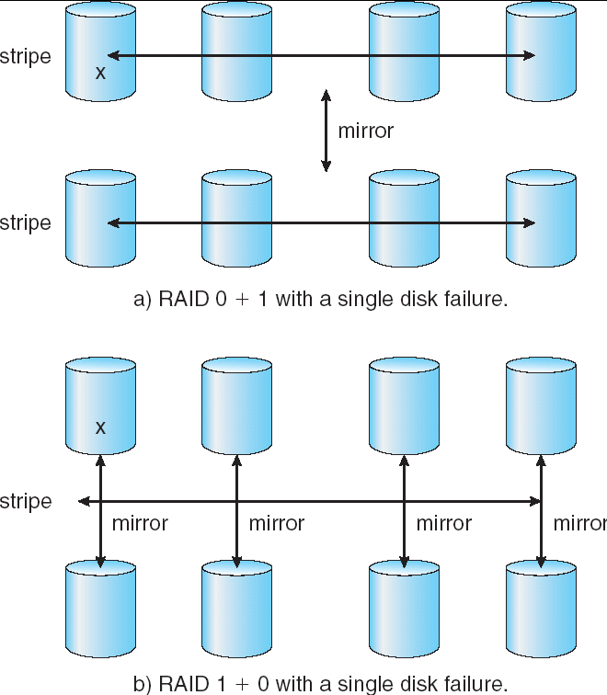
RAID 0+1 and 1+0

Slide 14
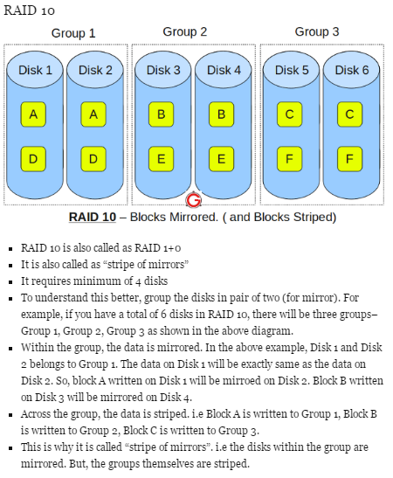

Slide 15
